Slide 1
Notes:
I was a student at NTNU, and I've studied music technology and computer science there. Last year, I did a project where I combined music technology and AI. I creating a piece of software where you can input two sounds and say I'd like the first sound to sound like the other sound. This is achieved by using cross-adaptive audio effects. I'll explain how that works in a moment, but first let's listen to some example sounds.

Slide 2
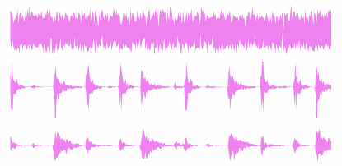
Notes:
There's white noise. And a drum loop. Now, the job of my software is to process the white noise to sound more like the drums. This last sound here is white noise processed by the software. It’s what I call the output sound.

Slide 3
Notes:
When I say the sound is processed, I mean that an audio effect is applied. In my experiments, I've been using an audio effect that consists of distortion and a resonant low-pass filter. Let me illustrate.

Slide 4
Notes:
We have the input sound to the left, it goes through the audio effect. And out comes the output sound. The audio effect has a set of knobs that we can turn. In order to make the noise sound like the drum loop, we have to control the effect knobs over time. For example, to resemble a kick drum, the noise needs to sound dark. Then a moment later the noise needs to sound bright to resemble the snare drum. As I'm using a cross-adaptive audio effect, the knobs will be controlled over time based on signals from another sound source, namely the target sound.

Slide 5
Notes:
How can a stream of sound control a set of knobs? First we analyze the target sound, so we get a set of audio features. These features can be anything, for example low-level signals like noisiness or spectral centroid. It could in theory also be something more high-level, such as the probability of the presence of a male voice
But how do we use these audio features to control the effect knobs? There are a lots of possible ways to connect these audio features to the knobs. Last year, one of my advisors, Øyvind Brandtsegg created a toolkit for experimenting with cross-adaptive audio effects. He found that it was hard and tedious to find useful and musically interesting mappings manually. Also, he says that while many low-level features are mathematically and acoustically well-defined, they can often not be used directly to make musically interesting effects. However, if we combine the low-level features in complex ways, we might be able to get something more useful out of them. So he offered me this project where the goal was to use Artificial Intelligence methods to create these mappings automatically.

Slide 6
Notes:
I decided to use a neural network in this mapping. A neural network is basically a graph with a number of input nodes and a number of output nodes. It can also have intermediate nodes, typically called hidden nodes. There are edges between the nodes, and each edge has a weight, telling how much signal should pass through it. Here's how that works. Let's take this network for example. We have three inputs and two outputs. Calculating the output of a node is easy. You sum the incoming signals and run that sum through an activation function.

Slide 7
Notes:
Anyway, so the problem that my AI is tasked with is creating a good neural network. It has to decide where to add edges.

Slide 8
Notes:
how many hidden nodes should we add, and what should they be connected to

Slide 9
Notes:
And last, but not least, what should the weights be. To enable the artificially intelligent piece of software to experiment with the mapping and try different things, it needs to have a concept of what’s a good solution. Human beings can rate a solution by listening just to the sound and think for example “this sounds like garbage” or “this is not too shabby”.

Slide 10
Notes:
But we need something mathematically well-defined so the computer also can understand what’s good and bad. We call this a fitness function. It takes in a candidate solution and outputs a number between 0 and 1. 0 being awful and 1 being excellent. In my project I’ve been writing several fitness functions. One of them is based on similarity in the audio features of the output sound compared to the audio features in the target sound.

Slide 11
$$p$$
$$q$$
$$d\left(\vec{p},\vec{q}\right)=\sqrt{{\left(q_{1}−p_{1}\right)}^{2}+{\left(q_{2}−p_{2}\right)}^{2}+{\left(q_{3}−p_{3}\right)}^{2}}$$
Notes:
This slide shows two graphs: one for an output sound and one for the target sound. We would like the features of the output sound to be as close as possible to the target sound. For every time step, we can compute how different the features of one sound are compared to the other. We do this by taking the euclidean distance. If the features are exactly the same, this distance will be zero. If there are differences, then the number will be positive. If we compute the euclidean distance for each timestep, we can find the average euclidean distance.

Slide 12
Fitness $=\frac{1}{1+d_{avg}}$
Notes:
Here’s the fitness function. D is the average euclidean distance. It ranges from zero to infinity. You can see that a euclidean distance of 0, which is desirable, makes the whole expression evaluate to one, which is the highest score that the fitness function can return. A positive euclidean distance will yield a lower fitness value. For example, if d is 1, we get ½ which is 0.5.

Slide 13
Notes:
I’ve been using a genetic algorithm to try many different neural networks and eventually come up with something good. The algorithm I'm using is called NEAT, which stands for neuroevolution of augmented topologies. Neuroevolution means that neural networks are evolved with a genetic algorithm, and augmented topologies means that the algorithm can change the topology of the network. That just means it can add and remove edges and nodes. The genetic algorithm is iterative. It starts off with a set of candidate solutions.

Slide 15
Notes:
Some solutions will be better than others. These best solutions are more likely to produce offspring, that is small random variations of itself that will go on to the next iteration. And then the best solutions in that generation will produce random variations of itself again. This iterative process is likely to yield better and better solutions. You can see that on the following graph.

Slide 16
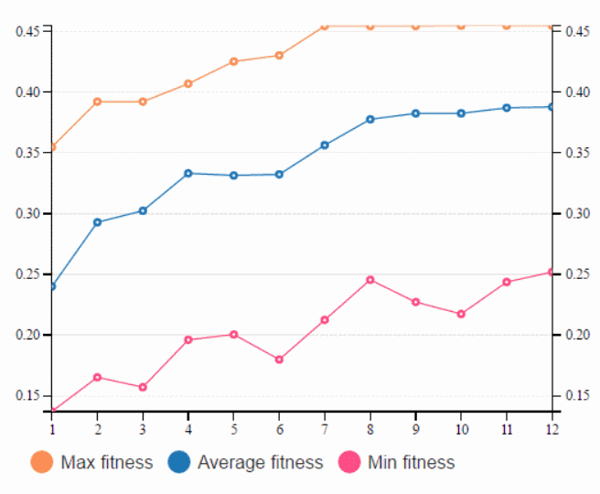
Notes:
On the Y axis we have fitness value and on the X axis we have the number of iterations. In fact, this graph is from the visualization part of my software. I created this software to ease the process of evaluating the results that the algorithm produces.

Slide 17
Notes:
In this experiment I’m using a synthesizer as input sound and the drum loop as target sound. You’ll hear them in the video.

Slide 26
twitter.com/iver56
github.com/iver56

